Slide 1
Understanding Zotero

Slide 2
Questions
Zotero
EndNote Web
RefWorks

Slide 3
Overview
Getting Started
Managing Your Account
Writing with Zotero
Demonstration

Slide 4
Getting Started
I. Getting Started
What is Zotero
Zotero vs. EndNote Web
Operating Systems
Downloading Zotero

Slide 5
What is Zotero
Zotero: (pronounced “zoh-TAIR-oh”) is a free web citation management tool that can be used to collect, manage, and cite research sources.

Slide 6
Criteria | Zotero | Endnote Web
Cost | Free | Free (.edu email address)
Web Base | Yes | Yes
Storage Capacity | Unlimited local storage; 500MB free Zotero file syncing | Limited to 50,000 citation; 2GB of file storage
Create Groups/Sharing Libraries | Yes | Yes, can’t share PDFs with groups
# Citation Styles | ~6400 | ~5000
Installation | Yes/No: Depends on the version | No (optional: Cite While You Write Plugin)

Slide 7
Operating Systems
Zotero:
Windows Vista, 7, 8, 8.1, etc.
Mac OS/X
Linux

Slide 8
Downloading Zotero
Download: Zotero 5.0 for Windows/ Macs/ Linux
Download: Zotero Connector (Firefox, Safari, Opera)

Slide 9
Managing Your Account
II. Managing Your Account
Opening
Layout
Adding Content
Tagging/ Sorting
Searching

Slide 10
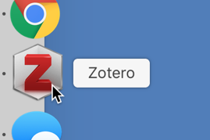
Opening

Slide 11
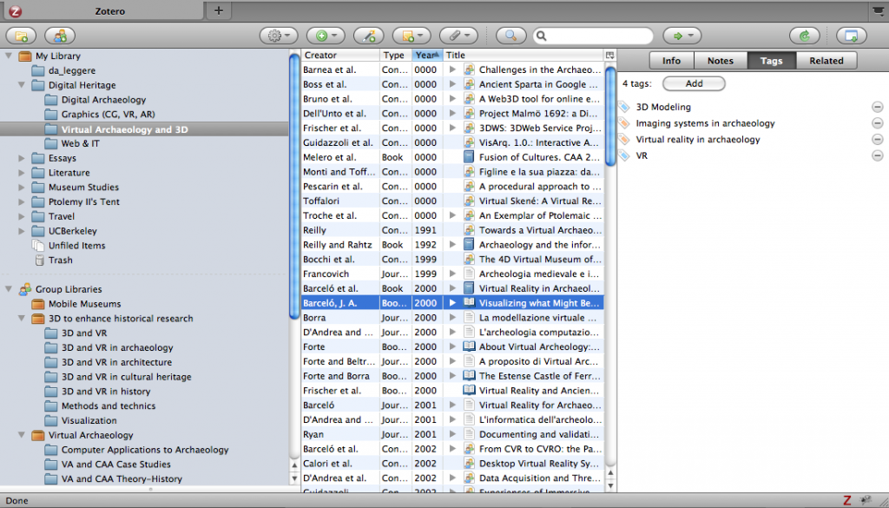
Layout

Slide 12
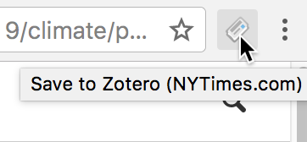
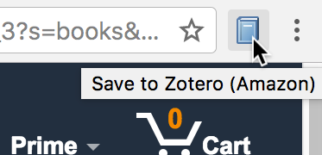
Adding Content

Slide 13
Adding Content (Manually)
Add “New Item”
Add item by “Identifier”
ISBN -- Worldcat
DOI -- Crossref
PMID – Pubmed
Create “New Item from Current Page”
Drag and Drop “PDF”
Drag PDF file to middle column
Right click – Retrieve metadata from PDF

Slide 14
Tagging/Sorting
Tagging
Add or Delete
Make item searchable
Subject, keywords, project related
Sorting
Title, Creator, Type, Date, etc…
Switch between descending and ascending

Slide 15
Searching
Search
Quick
Advance (Saved Search)

Slide 16
Writing With Zotero
III. Writing With Zotero
Bibliographies
In-text Citation
Syncing
Groups

Slide 17
Bibliographies
Click-and-paste
Word add-Ins Tools
Drag and Drop

Slide 18
In-text Citation
Word Document
Text-insert

Slide 19
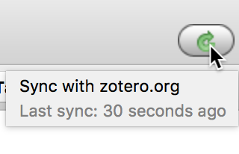
Syncing

Slide 20
Groups
Group Types
Private Group
Public, Closed Membership
Public, Open Membership

Slide 21
Demonstration
https://www.zotero.org/

